Slide 1

Voltorb November 2022

Slide 2
Problem Statement
Rinki has a plant in her pot. That plant requires constant moisture level every time else in dry soil condition it may die soon. Rinki cannot be with the plant and care it every moment.
Build a device that nurtures the plant with the above condition
Measure the moisture level of the soil every moment.
Turn on the pump to supply water to the plant whenever moisture is low.
Motor should Turn off whenever moisture of soil gets normal.
Moisture level should be displayed.

Slide 3
Components required
Arduino
Moisture sensor
Relay switch
LCD + I2C Module
Motor
Motor Power supply

Slide 4
Algorithm
System that reads and displays moisture level and motor status
And controls as follows:
Case1: Low Moisture
Motor should turn ON
Display MOTOR ON
Case2: High Moisture
Motor should turn OFF
Display MOTOR OFF

Slide 5
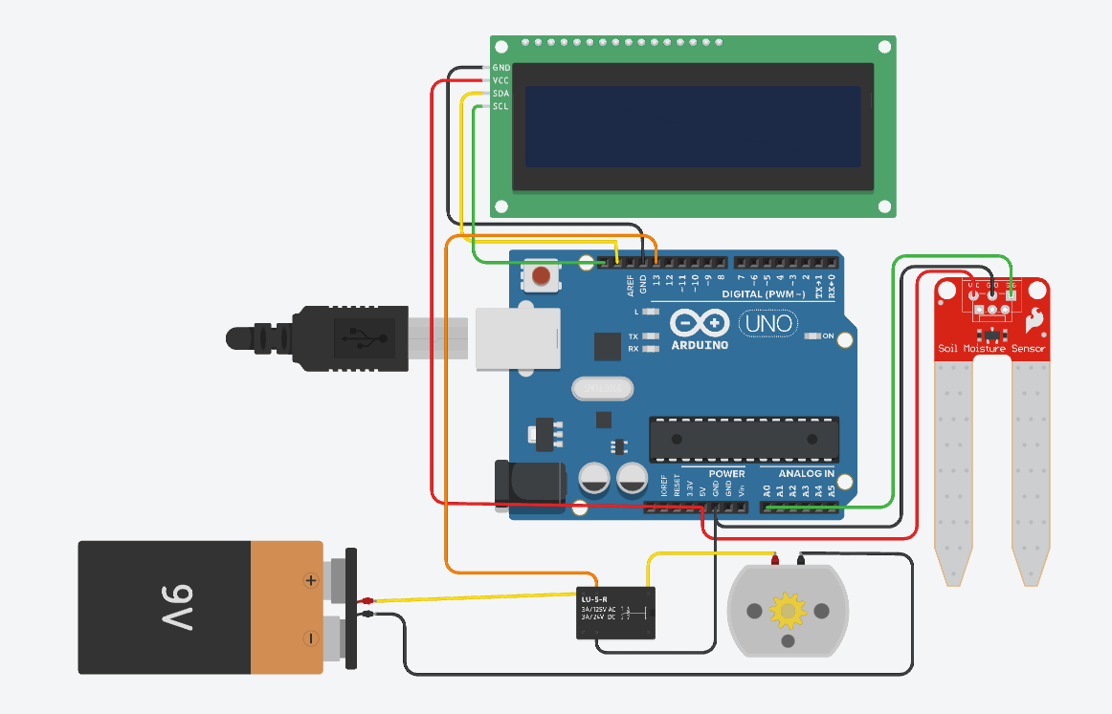
Circuit Diagram

Slide 6
Circuit Diagram
Connect Power supply and I2C Pins to Arduino and I2C LCD.
Connect Power supply and Analog Pin to Arduino and Moisture sensor.
Connect a relay to Arduino and ground.
Connect a 9V battery and a pump circuit via Relay Common pin and Normally Open pin.

Slide 7
Program
// C++ code
#include <Adafruit_LiquidCrystal.h>
Adafruit_LiquidCrystal lcd_1(0);
void setup()
{
lcd_1.begin(16, 2);//Begin
Serial.begin(9600);
pinMode(13,OUTPUT);
}
void loop(){
lcd_1.clear();
int moist = analogRead(A0); // read the sensor
lcd_1.setCursor(0,0);
lcd_1.print("Moisture = "+String(moist));
Serial.println("Moist = "+String(moist));
lcd_1.setCursor(0,1);
if(moist <= 500){
Serial.println("Motor ON");
lcd_1.print("MOTOR: ON");
digitalWrite(13,HIGH);
}
else{
Serial.println("Motor OFF");
lcd_1.print("MOTOR: OFF");
digitalWrite(13,LOW);
}
delay(500);
}

Slide 8
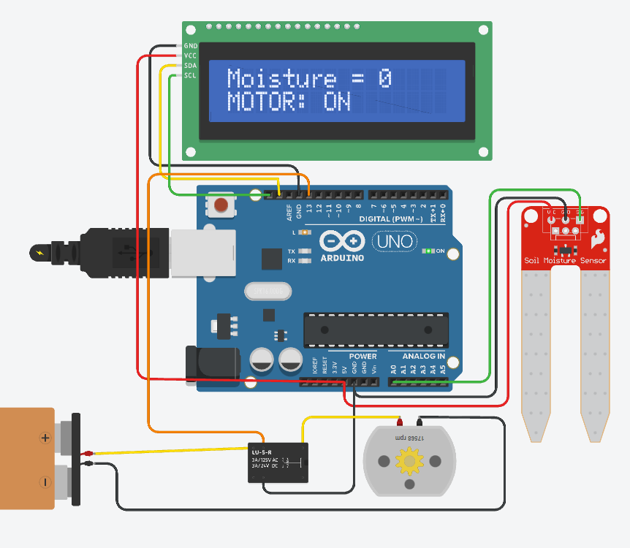
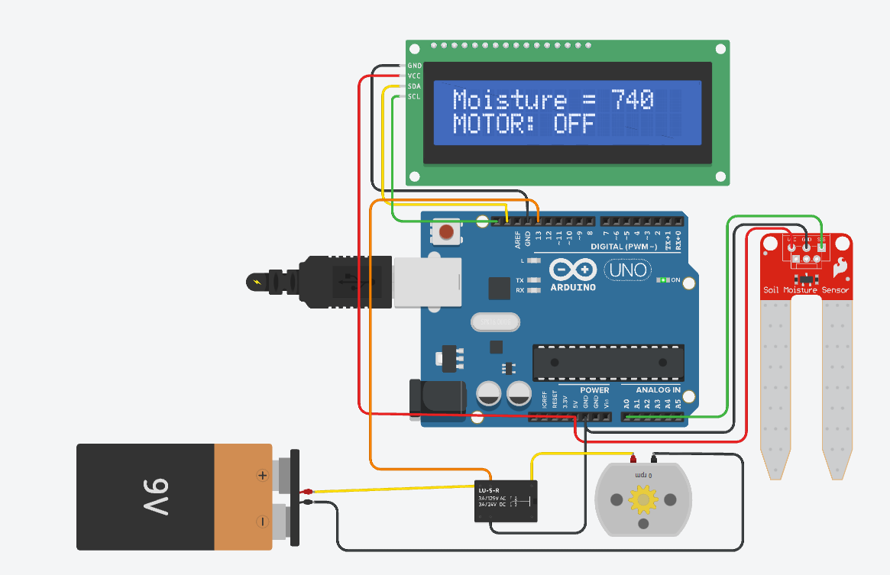
Output

